Slide 1
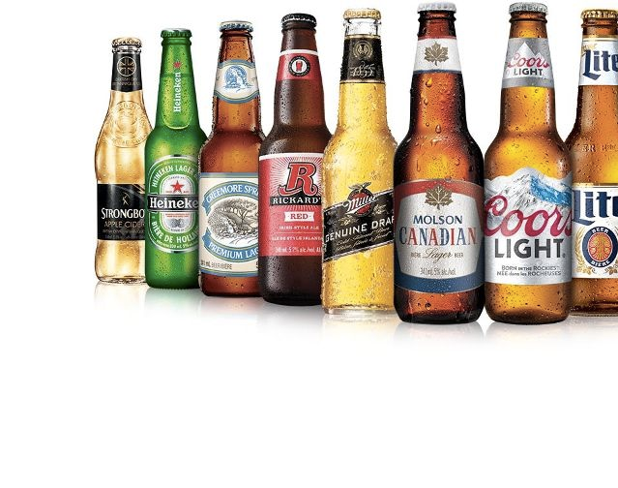
Molson Coors
Benjamin Day
Recommendation: Outperform; participate in 10 Year New Issue
06/19/2023

Slide 2
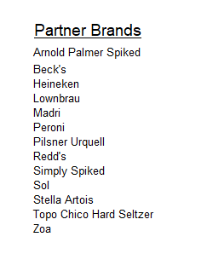
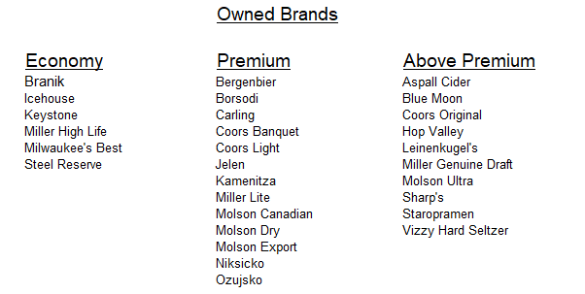
Company Overview
Molson Coors is a beer and spirits manufacturer that operates primarily in North America. It also has smaller segments in the EMEA and APAC regions. The company’s main competitors are AB Inbev, Asahi, Carlsberg, Constellation, and Heineken.
Coors produces 3 types of brands. Economy, Premium, and Above Premium. The company also licenses out certain brands to third parties.

Slide 3
Company Overview
In the US, beer is distributed through a three-tier system consisting of manufacturers, distributors, and retailers. Coors relies on distributors to transport 97% of its product in the US and retains long term contracts with them.
The company uses raw materials to produce its products such as water, hops, wheat, and barley. The prices of these inputs can become volatile, but Coors uses derivatives to hedge its purchases.
Beer consumption is seasonal, with around 37% of sales taking place in the summer months.
Alcohol is a regulated product and Coors is charged Excise taxes on its beer sales.

Slide 4
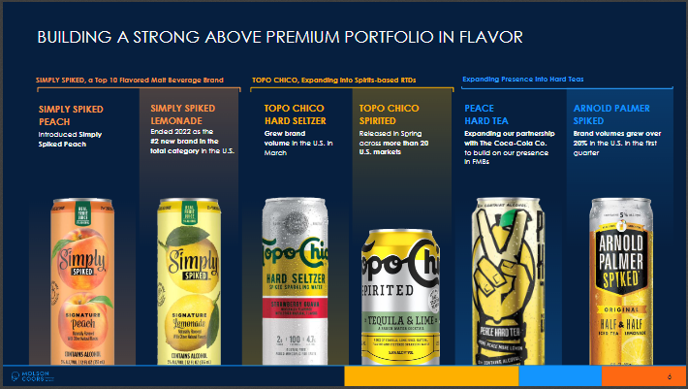
Revitalization Plan
In late 2019, Coors began a restructuring initiative called the Revitalization Plan. The company moved its headquarters to Chicago and consolidated other parts of the business. The company incurred significant cash and non-cash restructuring charges and recognized asset impairments.
The objective of the plan was to achieve long term cost savings and build a portfolio focused on more premium brands like seltzers and spirits.

Slide 5
Industry Analysis
Coors and its competitors have felt input cost inflation that began in the second half of 2021. This has had a negative impact on hectoliter volumes produced and purchased. The companies have passed through multiple waves of price increases to the end consumer. Cost inflation is expected to moderate in 2H 2023.
Over the last decade, the brewing industry has consolidated to a small number of increasingly large players which dominate the worldwide beer market.
Changing consumer trends are pushing the industry towards production of more premium brands. The traditional beer market is at maturity, but these new premium brands such as seltzers, malt beverages, and spirits remain a major focus area for all the major beer manufacturers.

Slide 6
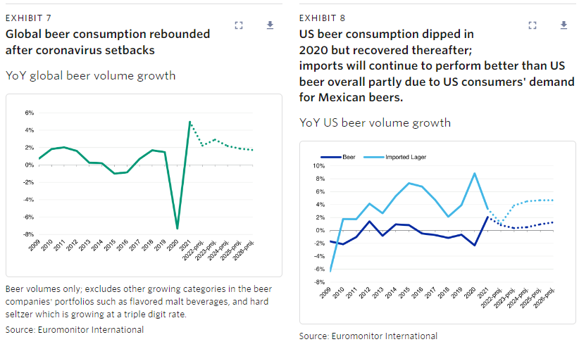
Industry Analysis
The Russia Ukraine conflict which began in February 2022 increased the prices of raw materials, transportation, and energy. This has negatively impacted Coors, particularly in Eastern Europe. However, exposure is relatively immaterial to the size of other business segments.
The beer industry has largely recovered from the coronavirus pandemic. Coors has seen favorable YoY comps due to Omicron variant restrictions.

Slide 7
Fundamentals
Coors is well positioned with solid fundamentals. The revitalization plan has been a success. Cost savings over the last 3 years have been $605 million total. In addition, the company is more competitive in its above premium brand category with strong beyond beer offerings like spiked seltzers, peace hard tea, and topo chico.
The first quarter was extremely strong. Coors has been the largest beneficiary from the recent marketing headwinds for Bud Light and AB. It is unclear if the recent market share gains that Coors has seen will remain long term. We believe that most of the gains are temporary and will revert, however time will tell. The company has not changed its guidance despite the extremely strong first quarter.

Slide 8
Fundamentals
In Q1, Revenue was up 6.5% on pricing gains which more than offset lighter volumes. Inflation pressures remain although these are expected to abate in the second half of the year. Inventories have been managed well and are in a good spot to meet the upcoming summer demand. Coors continues to fire on all cylinders heading into the busy season.
Any top line growth in the future quarters and years will be driven by pricing as the company continues its transition to more premium brands. Volumes will be lower, however these premium brands are higher margin. We expect Coors revenue to stay relatively flat, but the company will be able to improve its margins through its premium offerings, gains in production efficiencies, and lower SG&A expenses as a percentage of revenue. (see revenue decomposition and income statement).

Slide 9
Fundamentals
Management has guided for single digit Sales and Adjusted EBITDA growth in 2023. Free Cash Flow is expected to be near $1 billion in 2023. They were very non-committal to raise guidance when pushed by analysts on their Q1 call. The company managed to push through pricing increases of 5-6% last year but this will soon revert to the historical 1-2% range. In addition, a large brewing partner contract is winding down in 2024. This will hurt volumes beginning in Q4. These factors impact our revenue projections from 2024 on. (see revenue decomposition).
Management reiterated its 2.5x net leverage goal and its commitment to at a minimum maintain Investment Grade ratings. We have forecasted Coors reaching its leverage target by YE 2024. (see credit metrics).

Slide 10
Technicals
Coors has positive technicals. The business is well capitalized with $1.83 billion in available liquidity (see liquidity chart). In addition, near term maturities of $500 CAD ($380 USD) can be covered by cash flow and issuance will not be necessary.
We see Coors as an idiosyncratic deleveraging story. While it may take the rating agencies some time, Coors is approaching their upgrade triggers. As a result, we have them on positive outlook with a projected BBB rating. If Coors continues its positive momentum and remains focused on driving operating efficiencies and deleveraging, we may upgrade them as they approach their leverage and margin targets. See the rating agency upgrade triggers on the next page.

Slide 11
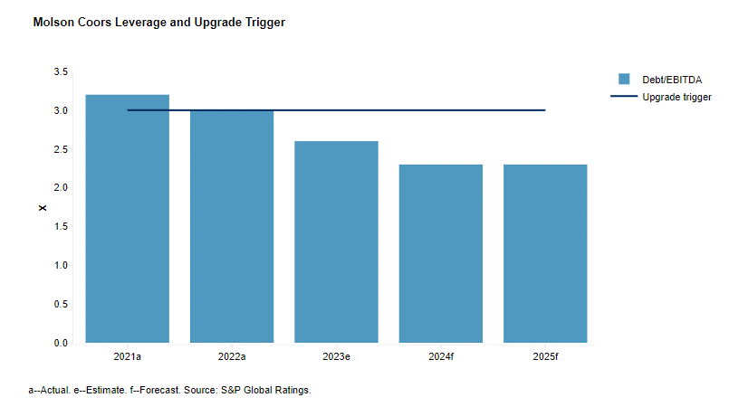
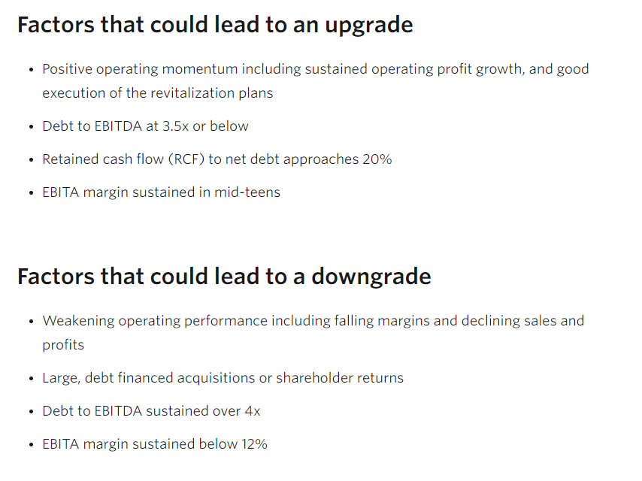
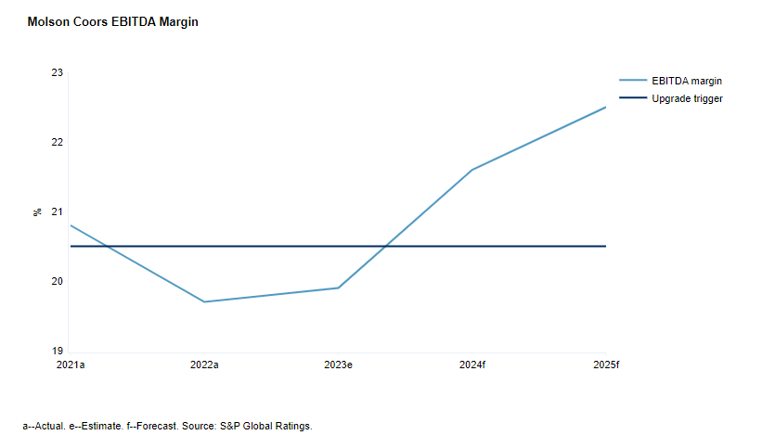
S&P
Moodys

Slide 12
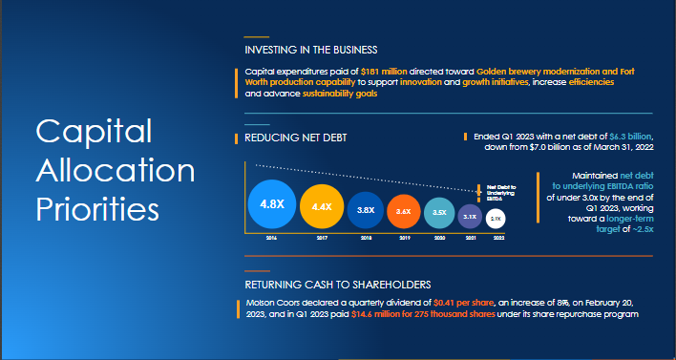
Coors Leverage Targets

Slide 13
Technicals
The global growth outlook for alcohol products is mixed. While premium brands and beyond beer are growing there is an increasing focus on health concerns around alcoholic products. This could hurt demand and in turn present a negative technical factor for all beer manufacturers. However, this also creates an opportunity for Coors and others to innovate and create low and no alcohol products in the future.
Coors lack of geographic diversification is a negative technical factor when compared to peers. The company is primarily focused in mature markets in the US and Canada. It is also smaller than its main peer AB Inbev. We expect Coors to diversify over time and this technical factor to lessen over time.

Slide 14
Comparable Analysis – Constellation Brands
Constellation is fairly similar to Coors but retains a greater focus on the premium beer space. They are the top brewer of imported beer in the US. Their top beer products include Corona and Modelo. They also have a smaller wine and spirits segment which represents around 20% of sales. Constellation currently has stronger margins than Coors due to its more premium offerings. In addition, sales growth will likely be stronger. They have a higher debt load, but they are still better positioned than Coors due to their premium offerings. They are rated BBB/Baa3 by the rating agencies. Management is more shareholder friendly and growth oriented.
We believe that Coors will be able to close this margin gap over time as the Revitalization plan continues and they transition to higher margin offerings. If Coors is able to successfully delever and is upgraded to BBB we feel it should trade in line, or potentially tight of STZ depending on relative leverage and interest coverage metrics.

Slide 15
Comparable Analysis – Anheuser Busch InBev
AB InBev is much larger and diversified than Coors. They have the largest worldwide market share in beer. Annual production volume is 595 million hectoliters per year. Emerging markets represent around 60% of sales which gives the company a stronger growth profile. Similar to Constellation and Coors the company is slowly moving its portfolio to more premium products like spirits. The company was upgraded to A-/A3 by S&P and Moodys in Q1 2023. Despite the backlash towards Bud Light harming sales in the U.S., AB is on a strong deleveraging track. Our base case is over time they will be able to recapture the market share in the U.S. that was temporarily lost to Coors. AB bonds should trade well inside of Coors.

Slide 16
Valuation
We view the valuation of the new issuance to be attractive at both the 10- and 30-year points. The 10 year comes with 25 bps of new issue concession vs the existing bond while the 30 year has 30 bps of concession.
We favor the 10 year new issue over the 30 year because of the shorter duration. While we are comfortable with Coors fundamentals we would like to take less duration in the name as we aren’t fully convicted on the fundamental story yet and see long term industry risks.
We feel that the new issuance provides decent optionality. If the new issue tightens to trade near the secondary issue it can be flipped, but if this does not happen we feel good overall about the fundamental story.

Slide 17
Opportunity Set Analysis / Relative Value
Using the provided relative value chart we feel that TAP should trade 0-5 bps behind STZ at the 10 year point and 10-15 bps behind STZ at the long point. Over time we believe this relationship should favor Coors due to more conservative management, deleveraging, and improving margins.
We believe TAP should trade 40-50 bps wide of ABIBB at the intermediate point and 55-65 bps wide at the long point.
Overall, the new issue presents an opportunity to enter TAP at an attractive spread where there is initial tightening potential but a solid long term fundamental story.

Slide 18
Internal Rating
We rate TAP BBB- / Positive with a projected BBB.
We see TAP reaching their leverage target by YE 2024, in addition we expect margins to improve due to the company shifting to more premium spirits. The company is doing very well heading into the summer months. Management is relatively conservative and has indicated that they will almost certainly do no large-scale M&A.

Slide 19
Risks to Recommendation
A change in consumer preferences away from spirits and more premium offerings. High industry operating leverage would make a transition to new offerings challenging.
A worse than expected recession that lessens discretionary consumer income.
Inability for the Revitalization Plan to achieve further cost synergies and savings.
Inability to diversify internationally.
Loss of market share to Constellation and AB.

Slide 20
Conclusion
In conclusion, we feel that Coors is an idiosyncratic deleveraging story. We are confident that the Revitalization plan will help Coors achieve more cost synergies and higher margins. The new issue provides an opportunity to enter this name at an attractive spread. We recommend to participate in the 10-year new issue and revisit to discuss a sale if we see spread tightening.
Thank you and I am happy to answer any more questions.

Slide 21
Sources
Company Filings
Bloomberg
S&P Global
Moodys
Euromonitor International

